Slide 1
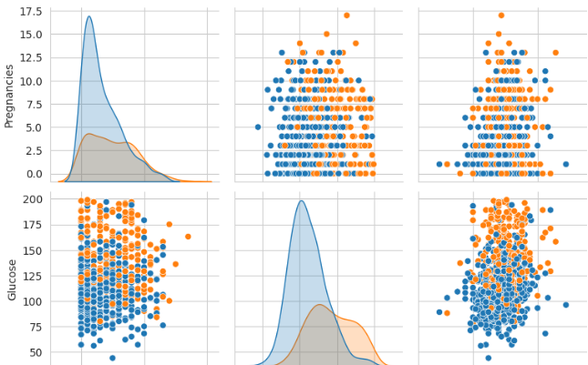
Data Analysis and visualization
Project on:
“Pima Indians Diabetes Database”
Submitted by:
BHOOMIKA SINGH (10834)
DHAVNI (10843)
AASHI BANSAL(10812)

Slide 2
INTRODUCTION
-> In this project, we will unveil the hidden patterns, gain insights, and present a visual narrative that goes beyond numbers through the lens of data analysis and visualization.
-> The Pima Indians Diabetes Database comes from an important study by the National Institute of Diabetes and Digestive and Kidney Diseases (NIDDK) in the 1980s. The study aimed to understand why diabetes was so common among the Pima Indians, leading to a lot of valuable data. This data has become a key foundation for healthcare analytics research.
-> The ‘Pima’ are a group of Native American people who traditionally lived in what is now Arizona in the United States.

Slide 3
SCOPE
The scope of our project encompasses a comprehensive analysis of the Pima Indians Diabetes Database, focusing on:
Exploring the diverse features within the dataset
Conducting Exploratory Data Analysis (EDA) to reveal underlying patterns
Utilizing visualization techniques to present complex relationships in an accessible manner
Building predictive models to understand factors influencing diabetes onset
Extracting actionable insights for healthcare strategies and interventions

Slide 4
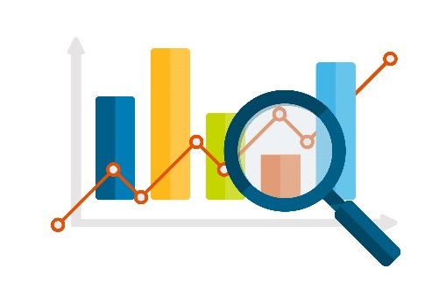
OBJECTIVE
Our primary objectives include:
Predict diabetes diagnosis for Pima Female Indians
Conducting a thorough analysis of the dataset's features
Uncovering correlations and relationships within the data
Utilizing visualization techniques to communicate findings effectively
Drawing actionable insights to inform future healthcare strategies

Slide 5
METHODOLOGY
DATASET:
-> Source:
https://raw.githubusercontent.com/dhwanimp3/data-analysis/main/diabetes.csv
-> Properties:
9 attributes (columns) representing 769 Pima Female Indians (rows)
-> Attributes:
1. Pregnancies: Number of times pregnant 2. Glucose: Plasma glucose concentration a 2 hours in an oral glucose tolerance test 3. BloodPressure: Diastolic blood pressure (mm Hg) 4. SkinThickness: Triceps skin fold thickness (mm) 5. Insulin: 2-Hour serum insulin (mu U/ml) 6. BMI: Body mass index (weight in kg/(height in m)^2)
7. DiabetesPedigreeFunction: Diabetes pedigree function 8. Age: Age (years) 9. Outcome: Class variable (0 or 1)"
CODING PLATFORM:
-> Google Colab
APPROACH FOR ANALYSIS:
-> This project adopts a collaborative approach combining expertise in data analysis, visualization, cleaning and healthcare.

Slide 6
LIBRARIES
The following python libraries has been used in the project:
-> import pandas as pd # for working with dataframe
-> import numpy as np # for numerical calculations
-> import matplotlib.pyplot as plt # for creating plots
-> import seaborn as sns # for finding outliers and data visualization

Slide 7
DATA EXPLORATION
-> In this, we explore the dataset to understand its structure, size, and basic statistics.
-> The functions we used to do so are:
1. df.head() – to display top 5 record
2. df.shape – to display total number of rows and column
3. df.columns – to display names of all the columns
4. df.dtypes – to display data type of all the columns
5. df.info() – to display the summary of the dataframe
6. df.describe() – to describe the data
Where, df = data frame/data set

Slide 8
DATA CLEANING
-> In this, we implement data cleaning steps to address missing values, outliers, and inconsistencies.
-> In our data we have minimum value 0 in certain columns where it is medically impossible, for example, BloodPressure cannot be zero. We also have outliers such Insulin being as high as 846. In this section, we will resolve null values, standardize data, check for duplicate values, remove anomalies and outliers.
-> The functions we used to do so are:
1. df.drop_duplicates() – to remove duplicate rows
2. df.isnull().sum() – to check for null strings and remove them, if any
3. df[df[‘<col_name>’]==0].shape[0] or df[‘<col_name>’].replace()– to find and replace the missing values
4. plt.subplot() – to create grid of subplots in a single figure
5. sns.boxplot() – to identify and plot the outliers
6. remove_outliers() – defined a function to remove outliers
7. df.describe() – to describe the data
Where, df = data frame/data set
sns = seaborn library
plt = pyplot from matplotlib

Slide 9
DATA VISUALIZATION
-> In this, we Create a variety of visualizations to explore relationships between variables. Include histograms, scatter plots, box plots, and other relevant plots to convey distributions and patterns.
-> The functions we used to do so are:
1. sns.countplot() – to plot the number of patients with and without diabetes
2. df.hist() – to see the distribution of variables in the dataset
3. plt.show() – to display the plots
4. plt.scatter() – to find relationship between variables
5. sns.pairplot() – to plot bivariate distribution, i.e., relationship between all the possible combination of variables
6. sns.heatmap() – to show the correlation
Where, sns = seaborn library
plt = plot from matplotlib

Slide 10
DATA ANALYSIS
-> In this, we categorizing, grouping and performing functions on data to draw conclusions.
-> The analysis on the data set was done by:
1. Showing the proportion of diabetes cases in each BMI category
2. Categorizing and visualizing diabetes outcome in different age groups
3. Showing BMI and Blood pressure in relation with the outcomes
4. Showing the distribution of insulin levels for diabetic and non-diabetic individuals

Slide 11
RESULTS FROM ANALYSIS

Slide 12
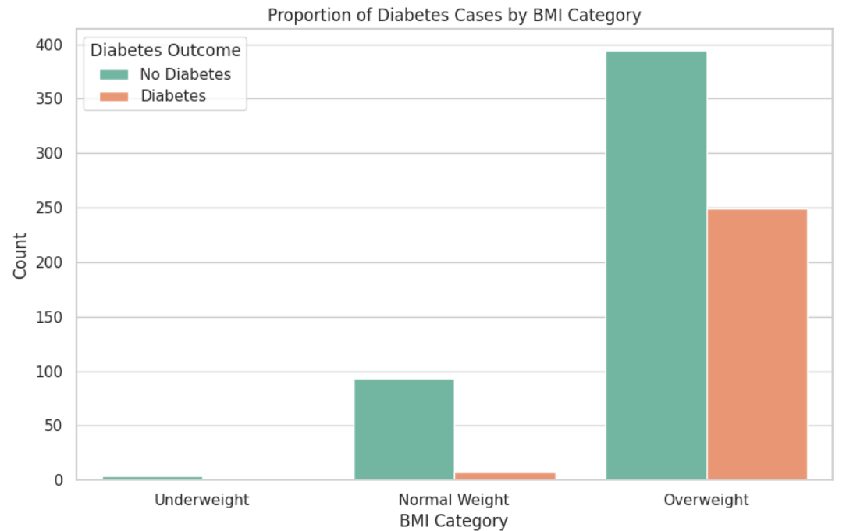
1. Showing the proportion of diabetes cases in each BMI category

Slide 13
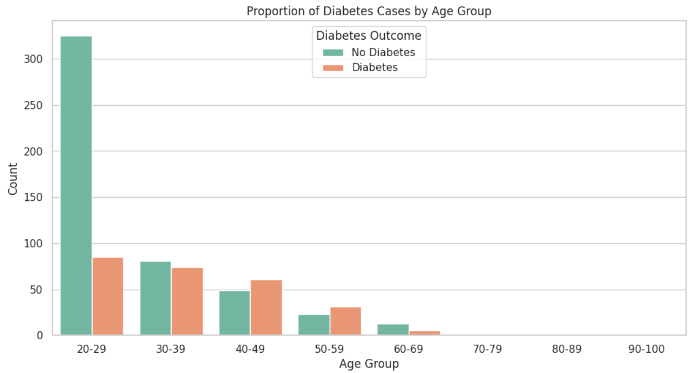
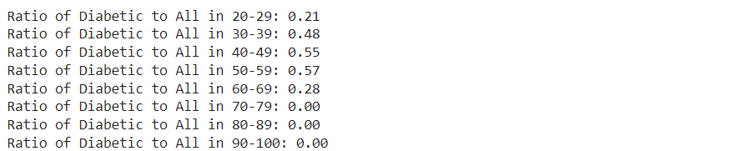
2. Categorizing and visualizing diabetes outcome in different age groups

Slide 14
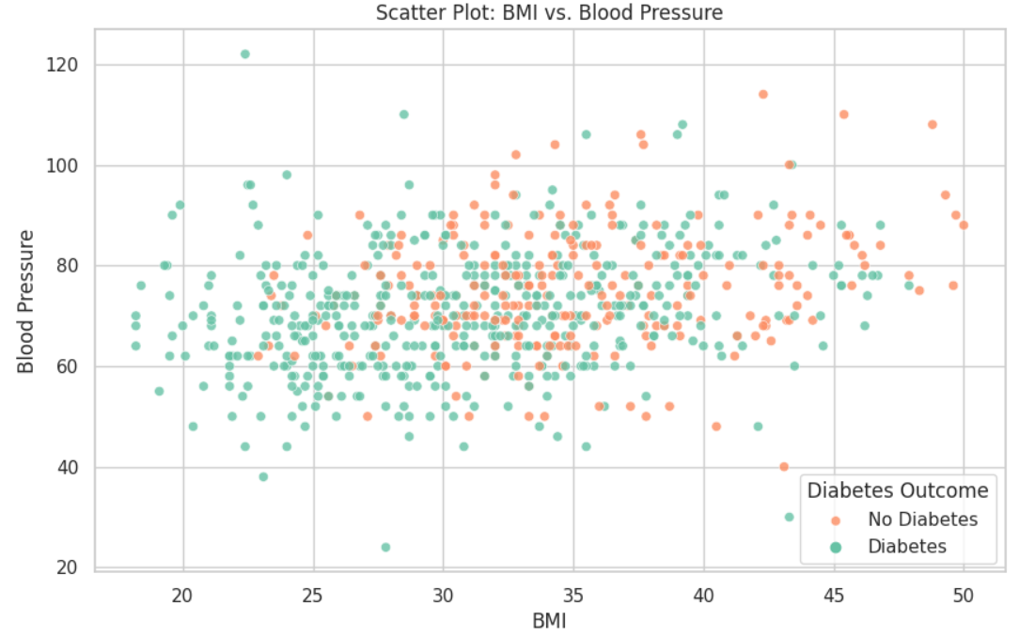
3. Showing BMI and Blood pressure in relation with the outcomes

Slide 15
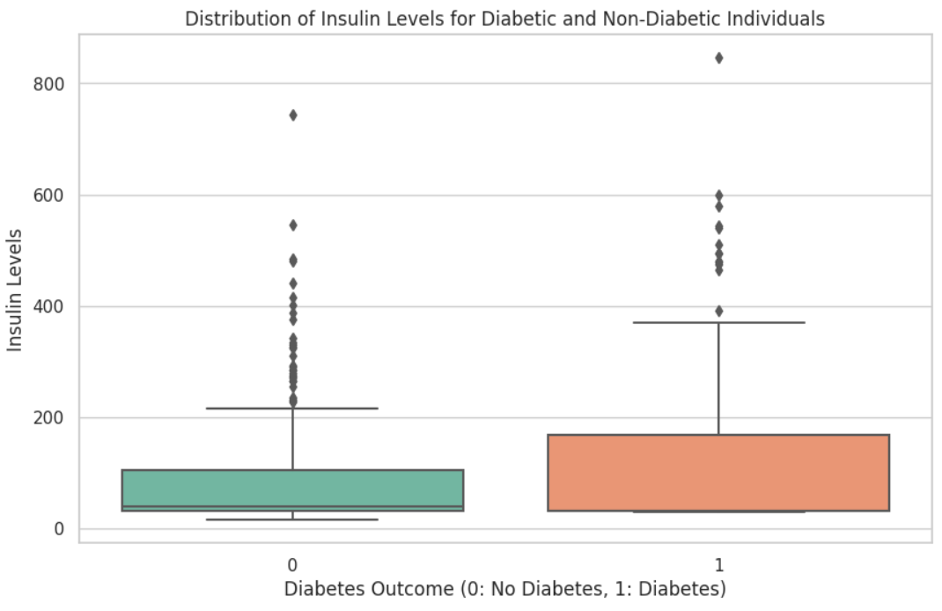
4. Showing the distribution of insulin levels for diabetic and non-diabetic individuals

Slide 16
CONCLUSIONS
-> We observed, the number of diabetes patients are more in the age group of 40-49 and 50-59 when compared to all the entries in these age groups. While women in the age group of 20-29 have lesser chances of diabetes.
-> Also, the points for diabetic patients cluster under the blood pressure of range (68-80) and BMI of (25-30).
-> Women with higher number of pregnancies have lower insulin.
-> We saw that Outcome of diabetes has correlation with Glucose, BMI, Age and Pregnancies. It has weaker correlation with other attributes.
-> Glucose and BloodPressure are evenly distributed. BMI becomes evenly distributed after removing outliers. Rest of the columns are skewed.

Slide 17
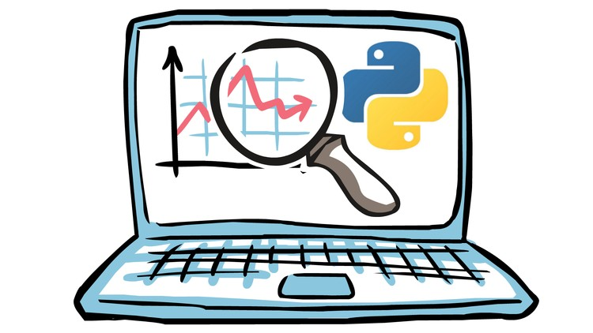
THANK YOU!
Submitted by:
BHOOMIKA SINGH (10834)
DHAVNI (10843)
AASHI BANSAL(10812)

